Slide 1
BUSQOM 1080 Multiple Regression II
Fall 2020
Lecture 12
Professor: Michael Hamilton

Slide 2
Lecture Summary
Review multiple regression [5 Mins]
Multiple regression with numeric and categorical variables. [10 Mins]
Mult. Regr. with numeric and categorical variables in R [10 Mins]
Dummy encodings of categorical variables [10 Mins]
Mult. Regr. with non-linear terms: Quadratic terms [5 Mins]
Mult. Regr. with non-linear terms: Interaction terms [5 Mins]

Slide 3
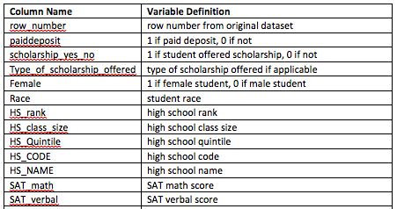
Data for lecture
Save cba_admissions_1999.txt in your working directory
cba =read.table(”cba_admissions_1999.txt", sep = "\t", header = T.
quote = “”, allowEscapes = T)
880 Student Obs
…

Slide 4
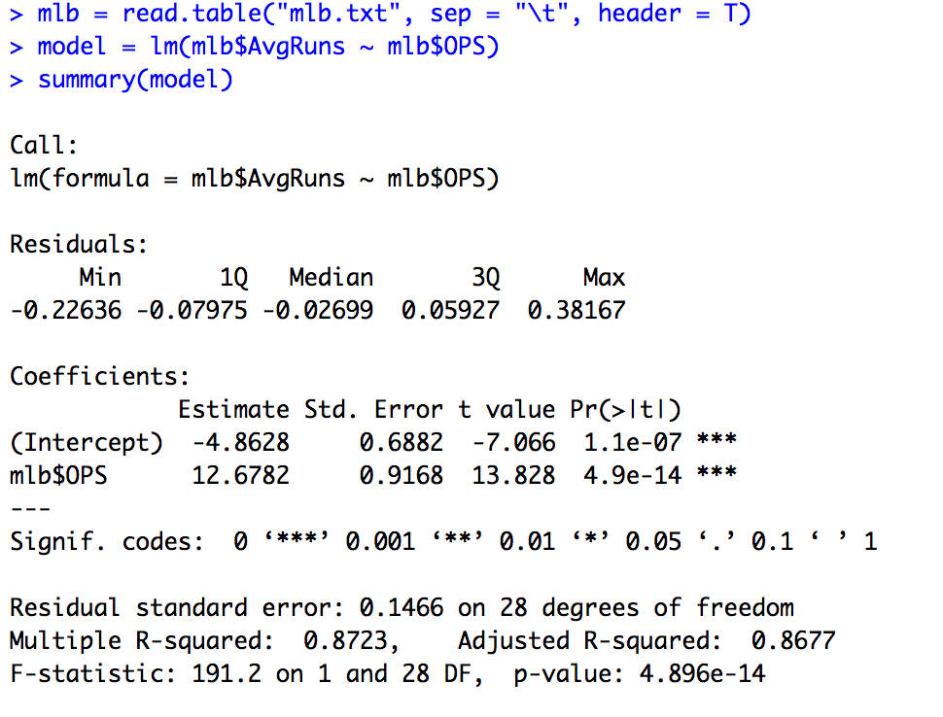

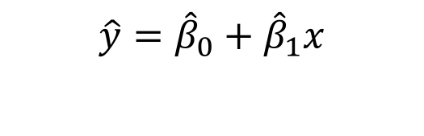
Review: Simple Linear Regression
Data: (x_{i}, y_{i}) pairs
Goal: Find the straight line that best fits the data
Find coefficients ${\hat{β}}_{0}$, ${\hat{β}}_{1}$ for linear model:
Example: Explain AvgRuns by team OPS
$$\hat{y}={\hat{β}}_{0}+{\hat{β}}_{1}x$$

Slide 5
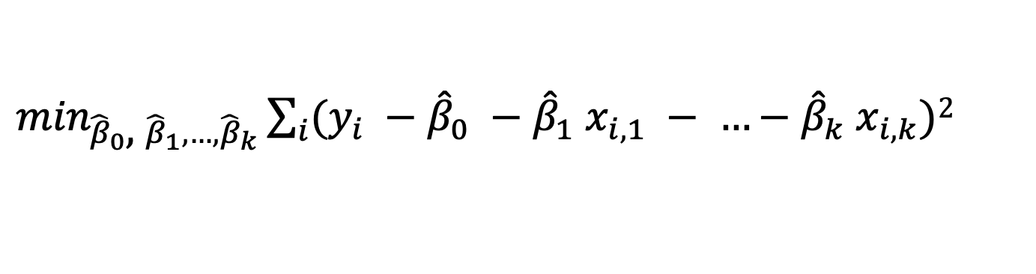
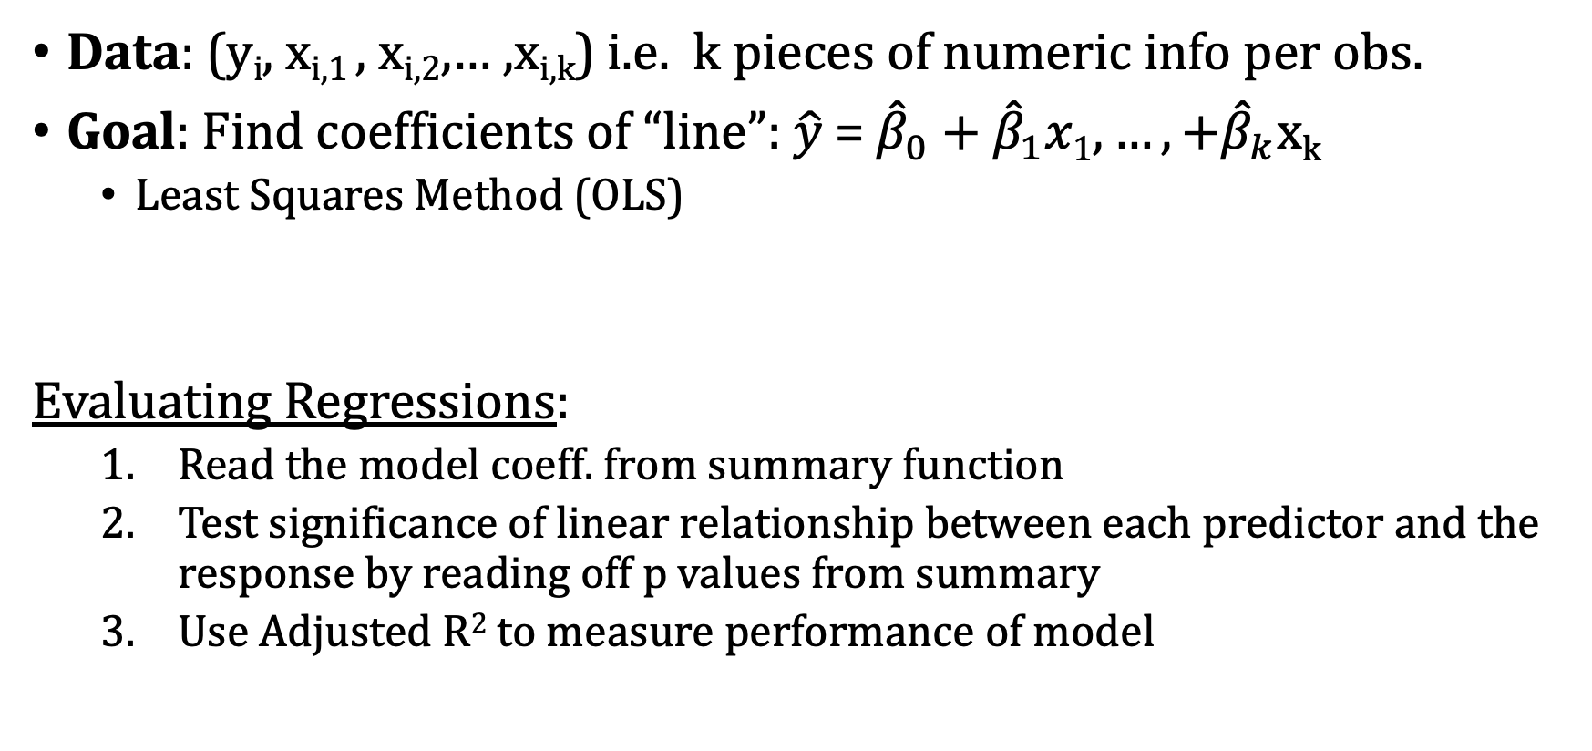
Review: Multiple Linear Regression
Data: (y_{i}, x_{i,1} , x_{i,2},… ,x_{i,k}) i.e. k pieces of numeric info per obs.
Goal: Find coefficients of “line”: $\hat{y}$ = ${\hat{β}}_{0}\text{ +} {\hat{β}}_{1}x1, …,+{\hat{β}}_{k}$x_{k}
Least Squares Method (OLS)
Evaluating Regressions:
Read the model coeff. from summary function
Test significance of linear relationship between each predictor and the response by reading off p values from summary
Use Adjusted R² to measure performance of model
$\min_{{\hat{β}}_{0}\text{, }{\hat{β}}_{1}, …,{\hat{β}}_{k}}\sum_{i}{(y_{i} −{\hat{β}}_{0} −{\hat{β}}_{1} x_{i,1} − …−{\hat{β}}_{k} x_{i,k})}$²

Slide 6
Review: Evaluating Mult. Lin. Regression
F-test (ANOVA table): Tells us whether any indep. vars are significant
H₀: β_{i} = 0 for all i (None of the X variables have linear relationships with Y)
H_{a}: β_{i} ≠ 0 for some i (At least one X variable has a linear relationship with Y)
Intercept: β₀ is the expected value of Y when all predictors are zero
Slope(s): β_{i} is the expected change in response (Y) for every 1 unit increase in X_{i}, while holding all other predictors constant.
Individual t-tests for each coefficient are reported in summary
R²: Proportion of variance in Y that is explained by features
Use adjusted R-sq because it adjusts for number of predictors (same interpretation) as opposed to regular r² which always increases in # predictors

Slide 7
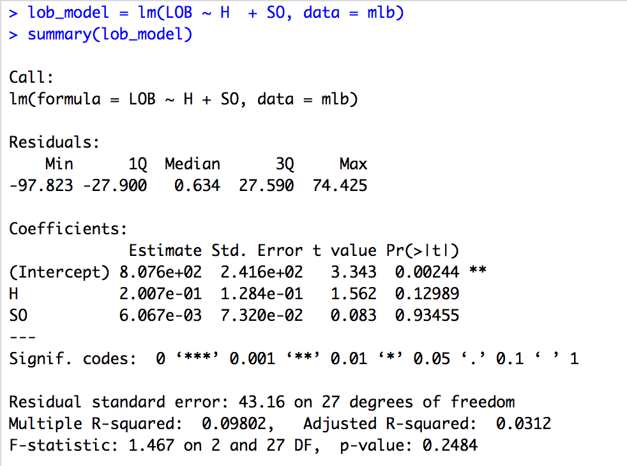
Review: Evaluating Mult. Lin. Regression in R
List all explanatory variables; separate with “+”
Regression Equation:
LOB=807.6 + .2007 Hits + .006067*Strikeouts
Significance of each predictor var.:
Intercept is signf., H and SO are not at 95% Confidence level
R² and adjusted r²
F Test for Signf., p-value

Slide 8
Topic: Beyond Numeric Features
Thus far we’ve seen regressions characterized by:
Numeric response (Y) variable
Example: SAT Verbal Score
Numeric explanatory (X) variable(s)
Example: SAT Math Score, ACT Score, Class Rank
Idea: Explanatory variables are not just limited to numeric variables! We can incorporate categorical and higher order variables into the regression equation with (almost) no additional work.

Slide 9
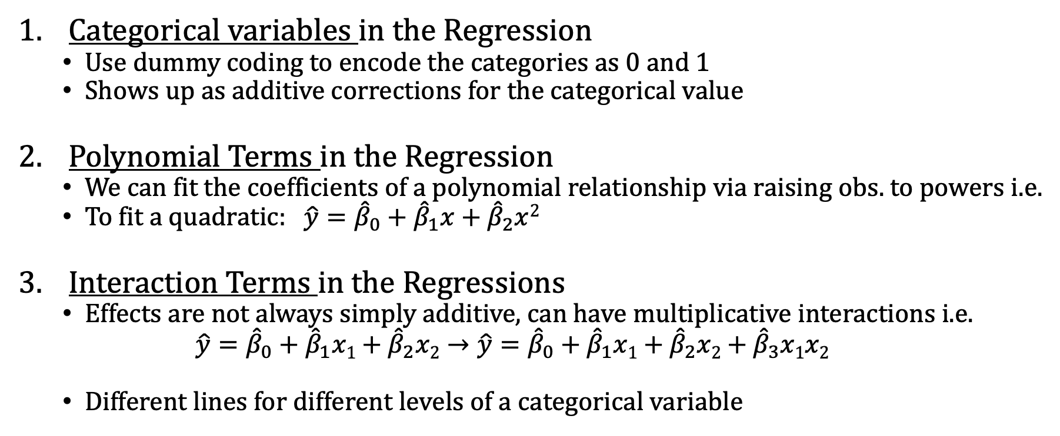
Topic: Heterogeneous Variable Types
Categorical variables in the Regression
Use dummy coding to encode the categories as 0 and 1
Shows up as additive corrections for the categorical value
Polynomial Terms in the Regression
We can fit the coefficients of a polynomial relationship via raising obs. to powers i.e.
To fit a quadratic: $\hat{y}={\hat{β}}_{0}+{\hat{β}}_{1}x+{\hat{β}}_{2}x$²
Interaction Terms in the Regressions
Effects are not always simply additive, can have multiplicative interactions i.e.
$$\hat{y}={\hat{β}}_{0}+{\hat{β}}_{1}x1+{\hat{β}}_{2}x2→\hat{y}={\hat{β}}_{0}+{\hat{β}}_{1}x1+{\hat{β}}_{2}x2+{\hat{β}}_{3}x1x2$$
Different lines for different levels of a categorical variable
New variable, simply the square of the x
New variable, product of x₁ and x₂

Slide 10
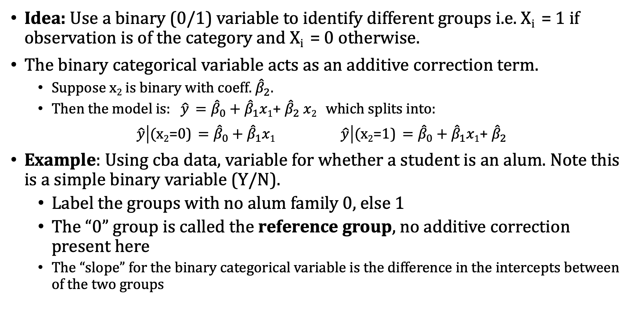
Topic: Categorical Vars and Dummies()
Idea: Use a binary (0/1) variable to identify different groups i.e. X_{i} = 1 if observation is of the category and X_{i} = 0 otherwise.
The binary categorical variable acts as an additive correction term.
Suppose x₂ is binary with coeff. ${\hat{β}}_{2}$.
Then the model is: $\hat{y} ={\hat{β}}_{0}+{\hat{β}}_{1}x1$+ ${\hat{β}}_{2}$ $x2$ which splits into:
$\hat{y}\left|\text{(}\text{x}\text{2}\text{=0)} ={\hat{β}}_{0}+{\hat{β}}_{1}x1 \hat{y}\right|\text{(}\text{x}\text{2}\text{=}\text{1}\text{)} ={\hat{β}}_{0}+{\hat{β}}_{1}x1$+ ${\hat{β}}_{2}$
Example: Using cba data, variable for whether a student is an alum. Note this is a simple binary variable (Y/N).
Label the groups with no alum family 0, else 1
The “0” group is called the reference group, no additive correction present here
The “slope” for the binary categorical variable is the difference in the intercepts between of the two groups
Additive Correction

Slide 11
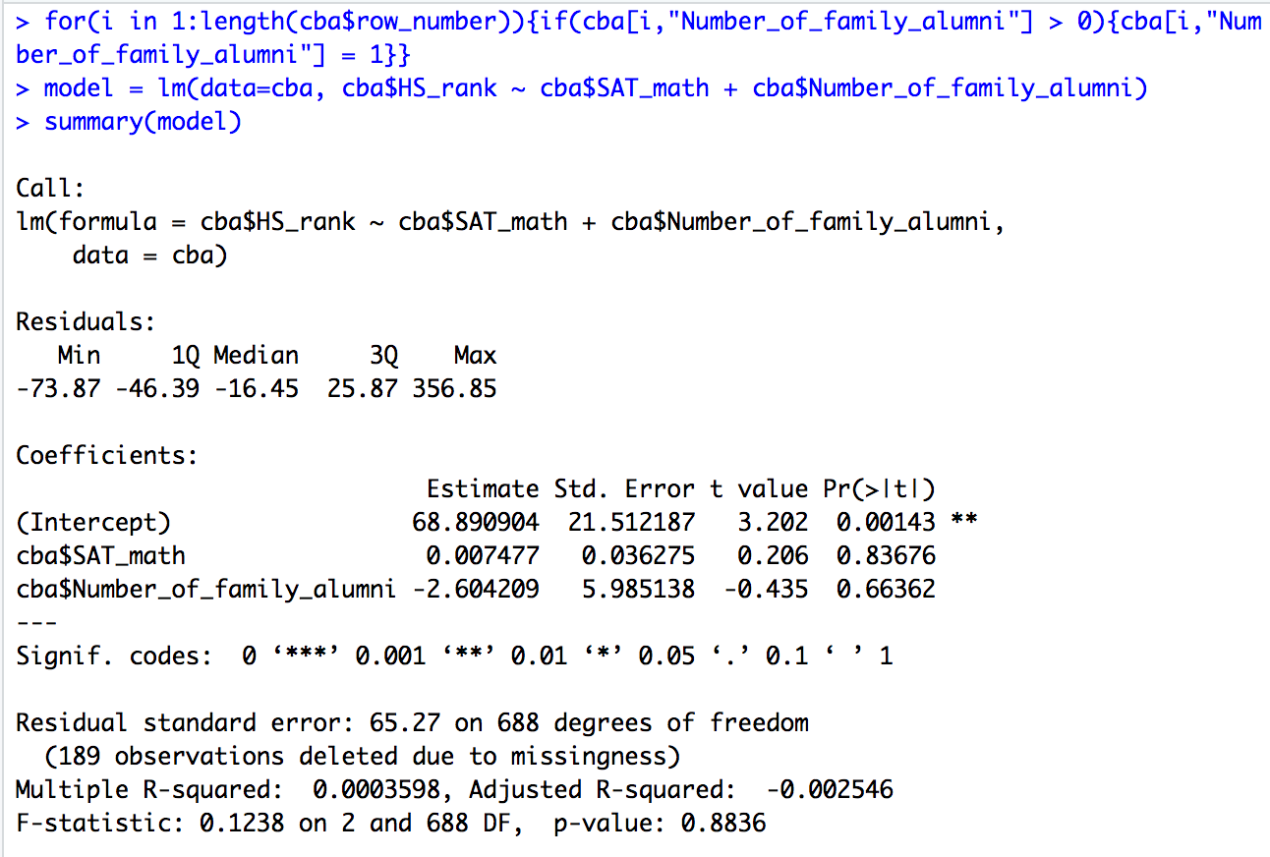
Topic: Handling Categorical Vars in R
Coding Notes:
Loop makes the feature binary, and sets it to 1 if any family are alums.
No alum is the reference group! (Why?)
Regression Equation:
Rank = 68.89 + .007*SAT_math – 2.6*(IF ALUM)
Not a good fit to the data

Slide 12
Dummy Coding with >2 Levels in R
Problem: Sometimes categorical variables have more than two levels!
Potential Idea: Code the categories as the numbers 1, 2, 3, 4
This doesn’t work unfortunately. Encoding features as numbers makes the numeric levels impact the regression equation! i.e. if we code a category as 4, it’s appear has 4 times the impact of level 1 categorical feature.
Example: Encode races {Black, Latinx, Pacific Islander} as {0,1,2}, then in the regression equation Black is the reference group, and Pacific Islander has twice the “impact” as Latinx…
Solution: We will use sets of binary (0/1) variables to identify different groups
Example: Insurance Type (payment method)
Levels of Category: Commercial, Medicare, Medicaid, Self-Pay, Other
Choose a reference group that will get absorbed into intercept
For remaining groups, create binary variable (1 if in that group, 0 otherwise)
Each group has a different intercept
The “slope” for each dummy variable signifies the difference between its intercept and the reference group’s intercept

Slide 13
Example of Dummy Variables as a Table
Insurance | Commercial | Medicaid | Medicare | Self Pay | Other
Medicaid | 0 | 1 | 0 | 0 | 0
Medicaid | 0 | 1 | 0 | 0 | 0
Medicare | 0 | 0 | 1 | 0 | 0
Self Pay | 0 | 0 | 0 | 1 | 0
Medicare | 0 | 0 | 1 | 0 | 0
Commercial | 1 | 0 | 0 | 0 | 0
Commercial | 1 | 0 | 0 | 0 | 0
Other | 0 | 0 | 0 | 0 | 1
We will encode the multi-level variable for Insurance as a set of four binary variables!
Each row has a “1” in exactly one column
One of the columns is redundant
If we know the values for 4 columns, we can figure out the fifth!

Slide 14
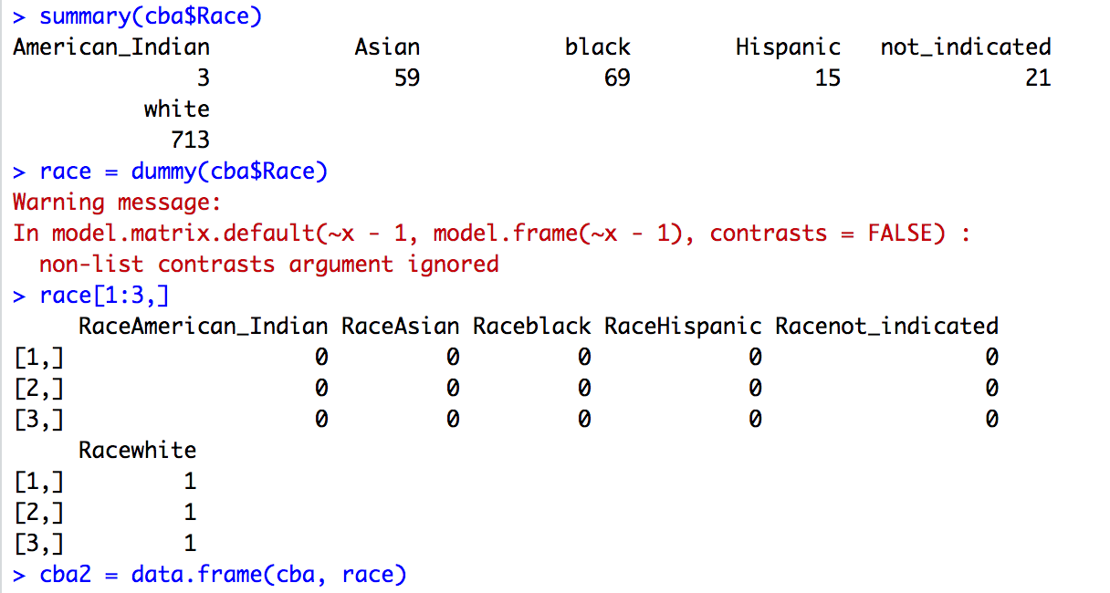
Creating Dummy Variables in R
>install.packages("dummies")
>library(dummies)
Notice that the feature Race is categorical with 6 “levels”
Use dummy() function to create dummy variables for each category/group
Append newly created dummy variables to your data

Slide 15
More on Dummies in R
We don’t need to create dummy variables in R, but they add flexibility.
Note: R will let you include categorical predictors in the regression equation and generate it’s own dummy variables.
Note: R will always treat the group that comes first alphabetically or numerically as the reference group
In some cases, we might prefer to create dummy variables and choose the reference group manually
Example: Low, Medium, High (R would select High as reference group, do you see why?)

Slide 16
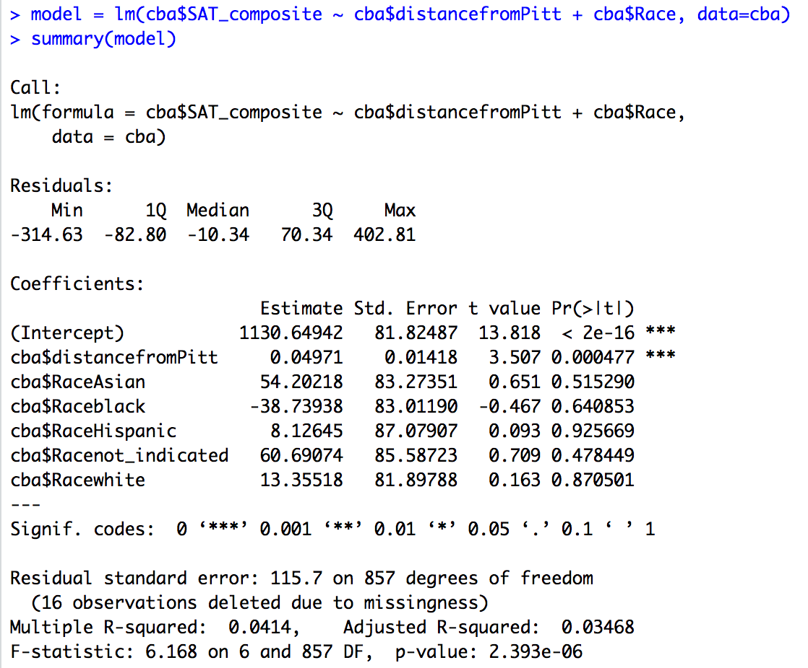
Example with Dummy Coding (Automatic)
Intercept: There’s one slope for level of the factor race
Disclaimer: None of the racial dummy variables are significant.
Disclaimer: The data is agnostic from the process that generates it. There’s no notion of systematic racism, socio-economic status etc. in the data. Up to you to interpret the model and make sound inference.

Slide 17
Topic: Interpreting Dummy Variables
Can add categorical variables to regression model, but first need to create dummy codes
If k categories, you only need k-1 dummy variables
Other category acts as reference group; absorbed into intercept
Each dummy variable acts as an indicator of whether the observation is in that category
Each dummy coefficients can be interpreted as the average difference in Y between the dummy category and the reference group.
Specifically the dummy coefficients are the linear correction in the model for that level, relative to the reference group.

Slide 18
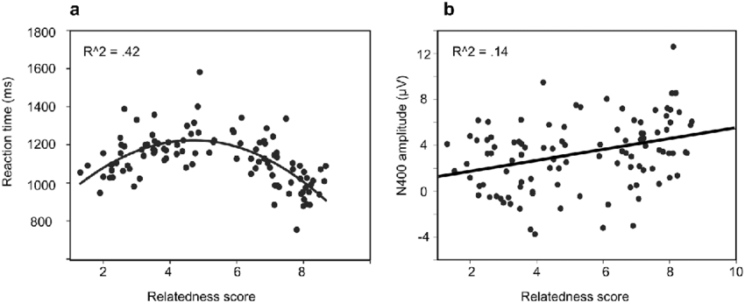
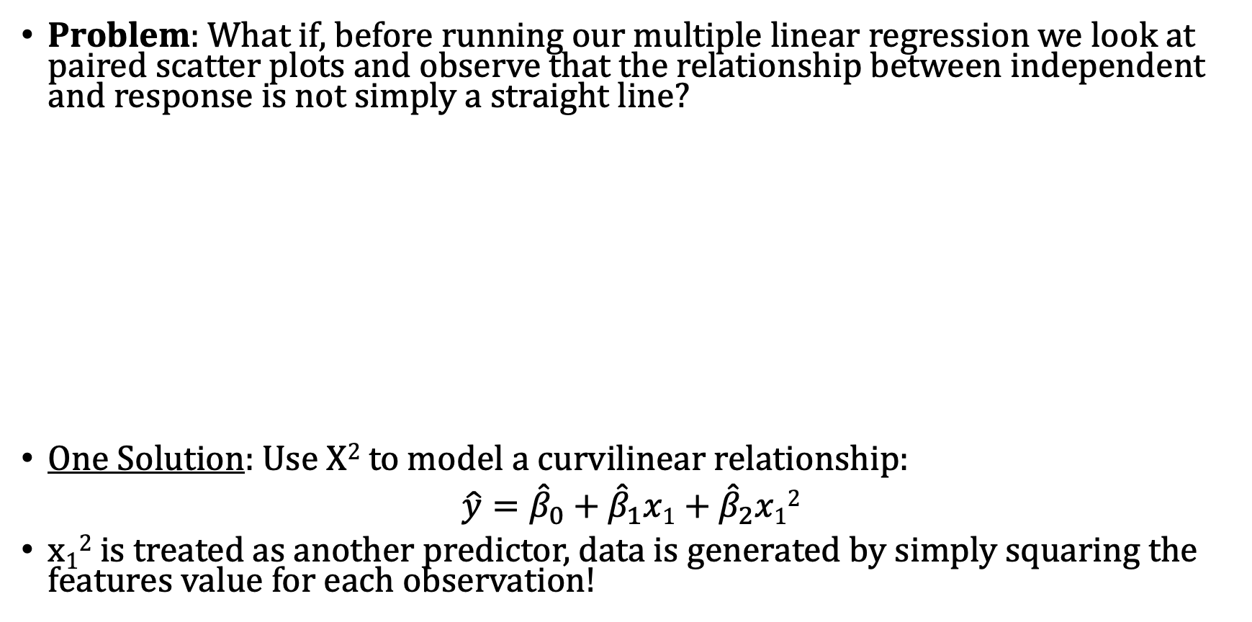
Mult. Regr: Quadratic Terms
Problem: What if, before running our multiple linear regression we look at paired scatter plots and observe that the relationship between independent and response is not simply a straight line?
One Solution: Use X² to model a curvilinear relationship:
$\hat{y}={\hat{β}}_{0}+{\hat{β}}_{1}x1+{\hat{β}}_{2}x1$²
x₁² is treated as another predictor, data is generated by simply squaring the features value for each observation!
(Barely) Linear Scatterplot
Rel.
Nonlinear Scatterplot Rel.

Slide 19
Mult. Regr: Quadratic Terms
A quadratic term is an interaction of a variable with itself, sometimes we suspect these relationships even without seeing the scatter plot.
Example: Modeling the effect of increasing the distance from Pitt on sat score might also be dependent on the current distance from Pitt, thus requiring a quadratic term.
Warning: Adding quadratic terms increases the number of variables in your model like anything else, and thus hurts the models r² unless this relationship is strongly present.
It’s also an easy way to overfit your data, can lead to bizarre predictions!

Slide 20
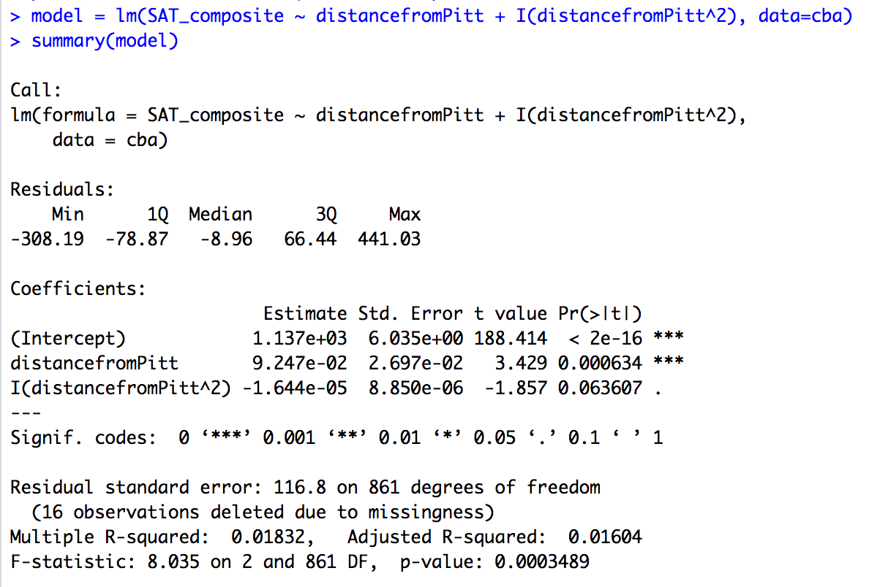
Example: Is SAT Score a quadratic function of the distance from pitt?
May opt to create new column, or use I() notation
To make quadratic term use syntax I(var_name^2)!
Note the quadratic Term is not significant here

Slide 21
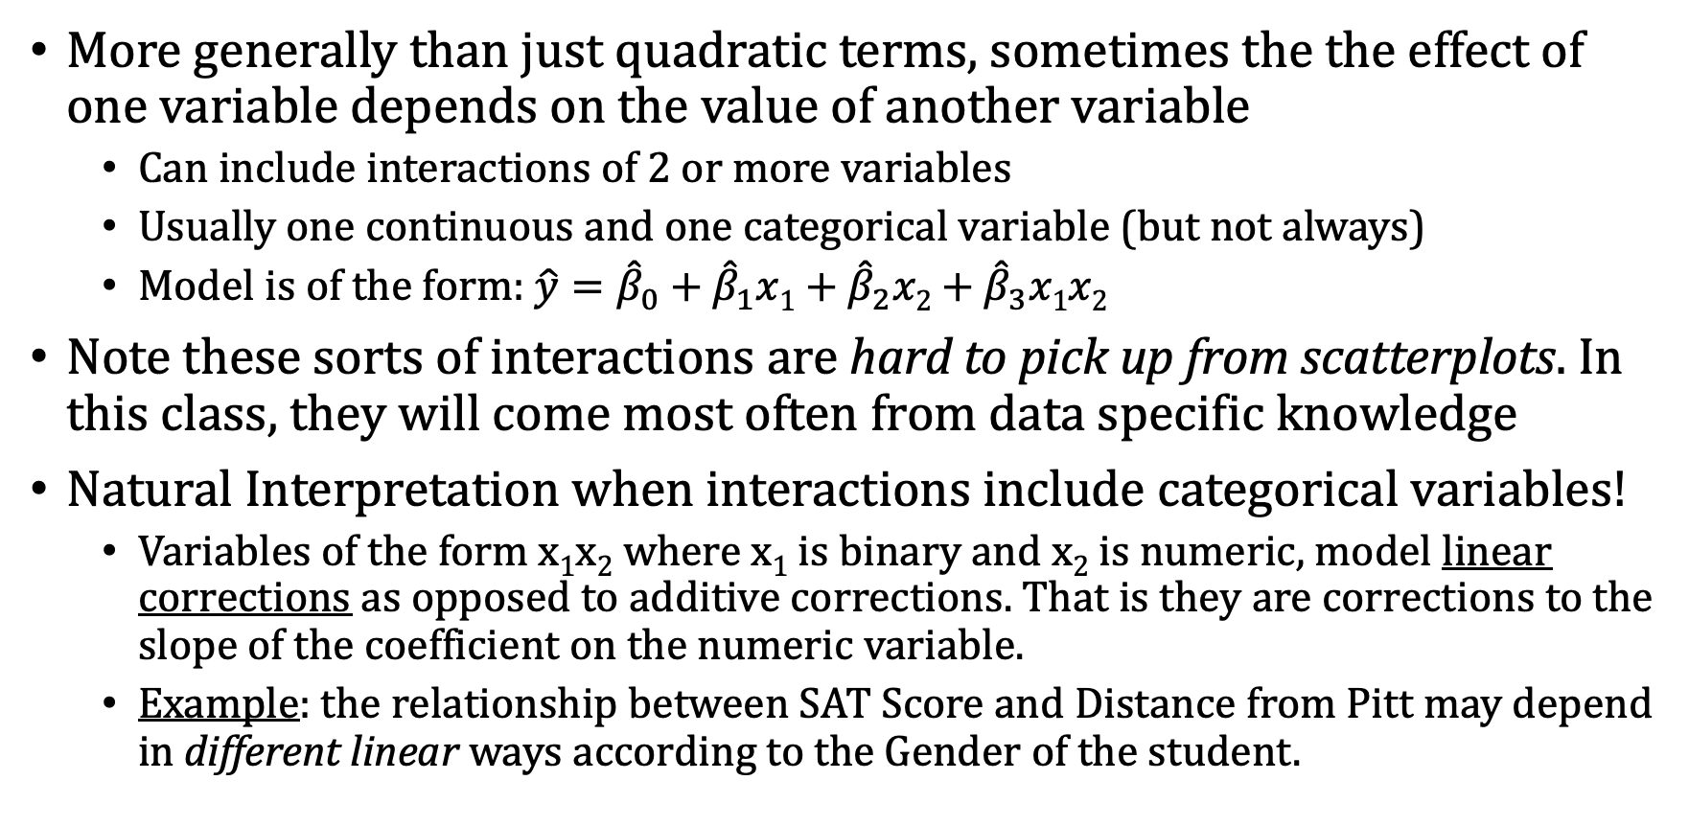
Mult. Regr.: Interaction Terms
More generally than just quadratic terms, sometimes the the effect of one variable depends on the value of another variable
Can include interactions of 2 or more variables
Usually one continuous and one categorical variable (but not always)
Model is of the form: $\hat{y}={\hat{β}}_{0}+{\hat{β}}_{1}x1+{\hat{β}}_{2}x2+{\hat{β}}_{3}x1x2$
Note these sorts of interactions are hard to pick up from scatterplots. In this class, they will come most often from data specific knowledge
Natural Interpretation when interactions include categorical variables!
Variables of the form x₁x₂ where x₁ is binary and x₂ is numeric, model linear corrections as opposed to additive corrections. That is they are corrections to the slope of the coefficient on the numeric variable.
Example: the relationship between SAT Score and Distance from Pitt may depend in different linear ways according to the Gender of the student.

Slide 22
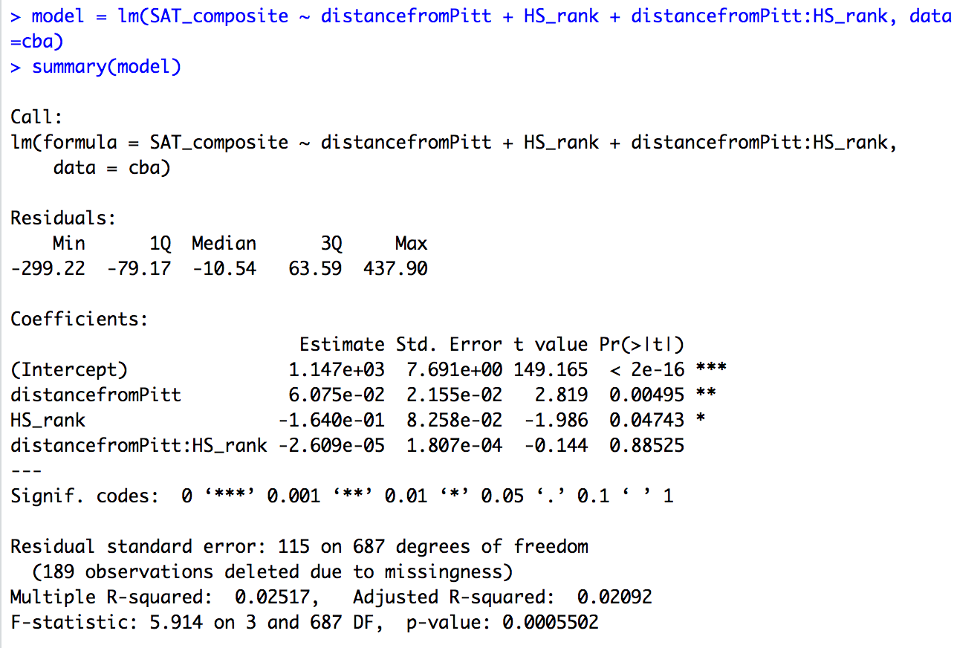
Example: Does the relationship between SAT and Distance depend HS Rank?
Syntax for interaction terms:
Variable 1:Variable 2
Interaction is not significant
Model does not explain much of the variance

